Slide 1
Total Probability and Bayes’ Rule

Slide 2
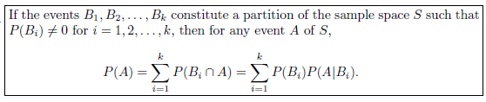
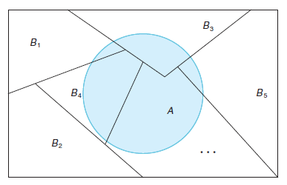
Total Probability

Slide 3
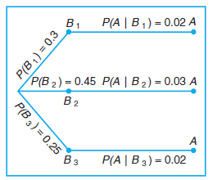
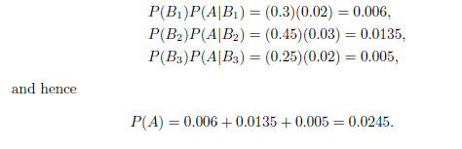
Example: In a certain assembly plant, three machines, B1, B2, and B3, make 30%, 45%, and 25%, respectively, of the products. It is known from past experience that 2%, 3%, and 2% of the products made by each machine, respectively, are defective. Now, suppose that a finished product is randomly selected. What is the probability that it is defective?
Solution:
A: the product is defective,
B1: the product is made by machine B1,
B2: the product is made by machine B2,
B3: the product is made by machine B3.

Slide 4
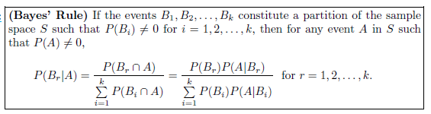
Bayes’ Rule

Slide 5


Example: In a certain assembly plant, three machines, B1, B2, and B3, make 30%, 45%, and 25%, respectively, of the products. It is known from past experience that 2%, 3%, and 2% of the products made by each machine, respectively, are defective. if a product was chosen randomly and found to be defective, what is the probability that it was made by machine B3?
Solution:
A: the product is defective,
B1: the product is made by machine B1,
B2: the product is made by machine B2,
B3: the product is made by machine B3.

Slide 6


Example: A manufacturing firm employs three analytical plans for the design and development of a particular product. For cost reasons, all three are used at varying times. In fact, plans 1, 2, and 3 are used for 30%, 20%, and 50% of the products, respectively. The defect rate is different for the three procedures as follows:
where P(D|Pj) is the probability of a defective product, given plan j. If a random product was observed and found to be defective, which plan was most likely used and thus responsible?
Solution:

Slide 7
Assignment Page No 76
2.95
2.96
2.97
2.98
2.99
2.101

